Slide 1



Subtopic 6 – Operations with Negative Numbers
LEARNING OUTCOME: Understand multiply and divide positive and negative numbers.
Objectives:
To add and subtract negative numbers.
To multiply and divide negative numbers.
To solve problems using different rules of arithmetic.
Keywords:
Number lines
Negatives numbers
Definition
Characteristics
Negative numbers are numbers that represent values that are less than zero. They show things like temperatures below zero, debts and losses.
Negative numbers have a negative sign (-) in front of them, telling us they are less than zero. They are smaller than positive numbers. They are like the opposite of positive numbers. Positive numbers are on the right side of zero, and negative numbers are on the left side.
When comparing negative numbers, the one with the smaller distance from zero is considered greater. For example, -3 is greater than -5 because -3 is closer to zero.
Examples
Negative Number
Non - Examples
Temperature: If the temperature drops below zero, like -10 degrees Celsius, it means it's colder than zero degrees.
Debt: When you owe money, the amount is represented by a negative number. For example, if you owe £100, it can be written as -£100.
-3 -10 -0.5 -⅔ -632.456
Positive Numbers: Positive numbers are greater than zero and are not negative.
Zero: Zero is not positive or negative.
5 0 2.5 ⅔ 200 45.67
Addition and Subtraction
Example 1 - I do…
Example 2 - We do…
Calculate
(a) $−4+2$
(b) $−6 −5$
(c) $10+(−4)$
(d) $3−(−1)$
Calculate
(a) $−8+5$
(b) $−6−9$
(c) $1+(−2)$
(d) $−4−(−3)$
Example 3 - You do…
Calculate
(a) $−8+5$
(b) $−6−9$
(c) $1+(−2)$
(d) $−4−(−3)$

Slide 2
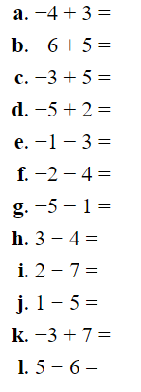
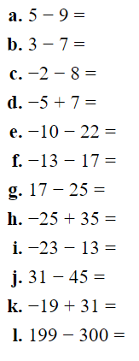
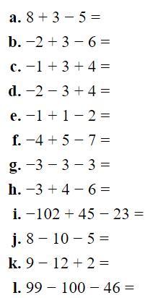
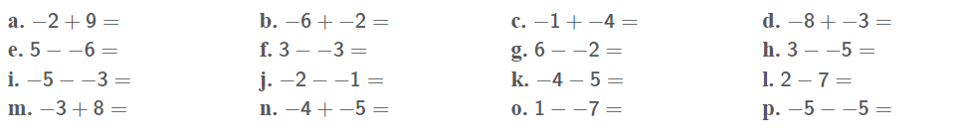
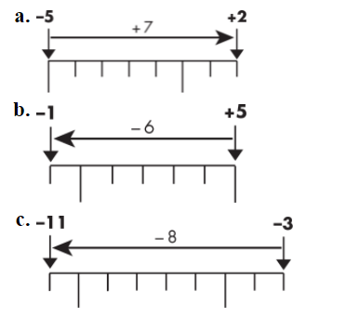
1. Complete these calculations.
2. Complete these calculations.
3. Work these out.
4. Evaluate.
5. Write down the calculations shown by these diagrams.

Slide 3
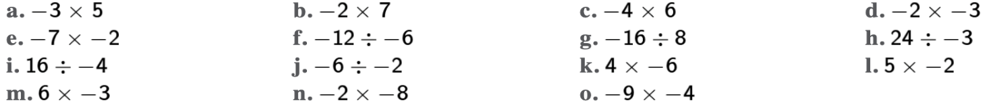

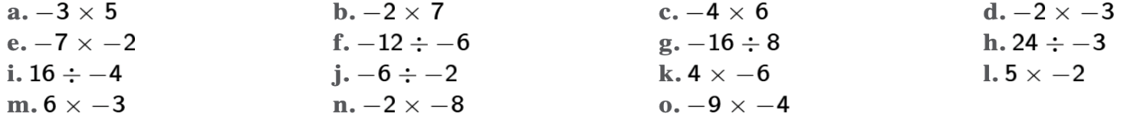




Arithmetic with negative numbers
Multiplication and Division
Example 4 - I do…
Example 5 - We do…
Work out
(a) $7×(−3)$
(b) $−10×(−4)$
(c) $−25÷5$
(d) $−3÷(−1)$
Work out
(a) $−11×4$
(b) $−9×−9$
(c) $−18÷3$
(d) $−16÷(−8)$
Example 6 - You do…
Calculate
(a) $−4 ×5$
(b) $−6×−$6
(c) $−28÷4$
(d) $−4÷(−2)$
6
Write down the answer to each calculation.

Slide 4

7
7. Put these calculations in order from lowest result to highest:
8
8. The rule for converting degrees Celsius (°C) to degrees Fahrenheit (°F) is:
Water freezes at 0 °C and boils at 100 °C. Work out the temperatures in degrees Fahrenheit that water freezes and boils at.
Work out the temperature that is the same in °C and °F.
9
9. CHALLENGE: Absolute zero is the lowest temperature possible. It is approximately -273.5 ºC. Use the formula in question 11 to work out absolute zero in °F. Give your answer to the nearest degree.

Slide 5
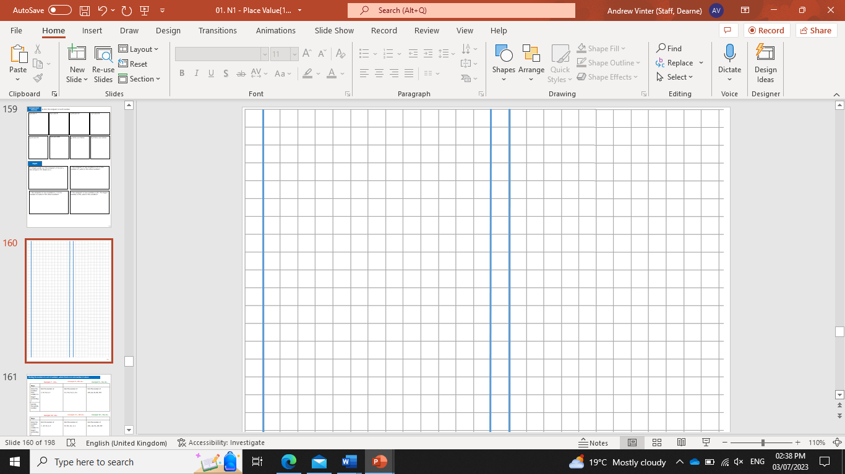
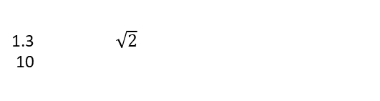
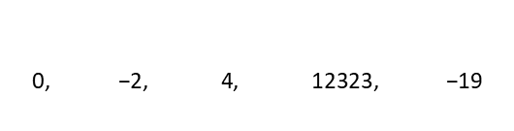
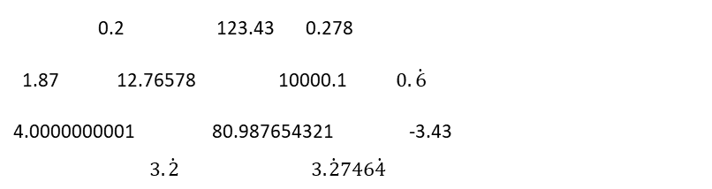


Subtopic 7 – Multiplying and dividing decimals
LEARNING OUTCOME: To multiply and divide with decimals.
Objectives:
Keywords:
- Decimal place
- Decimal point
- Dividing
- Multiplying
1. To multiply a decimal number by another decimal number.
2. To divide by a decimal by changing the calculation to division by an integer.
3. To answer worded questions on decimal calculations.
Definition
Characteristics
A decimal is a number that is not whole, as it lies between whole numbers.
Consists of a whole and a fraction part.
The fractional part is written as digits after a point rather than a fraction.
The whole and fraction parts are separated by a point called the decimal point.
Can be terminating or recurring.
Examples
Decimal
Non - Examples
$$38$$
$$1\frac{2}{3}$$
$$\frac{4}{5}$$
1.3 $\sqrt{2}$
10
0.2 123.43 0.278
1.87 12.76578 10000.1 $0.\dot{6}$
4.0000000001 80.987654321 -3.43 $3.\dot{2} 3.\dot{2}746\dot{4}$
240
$$\text{0, −2, 4, 12323, −19}$$
1 × 20 = 20 | so 1 and 20 are both factors of 20
2 × 10 = 20 | so 2 and 10 are both factors of 20
4 × 5 = 20 | so 4 and 5 are both factors of 20
Multiplying decimals by integers
Example 1 - I do…
Example 2 – We do…
Example 3 – You do…
Steps | Evaluate: | Find the value of: | Work out:
1) Multiply each decimal by a power of 10 so that they are integers | 4.3 x 2 = | 0.25 x 3 = | 2.3 x 3 =
2) Multiply the two numbers together
Divide your answer by the powers of 10 you multiplied by originally

Slide 6
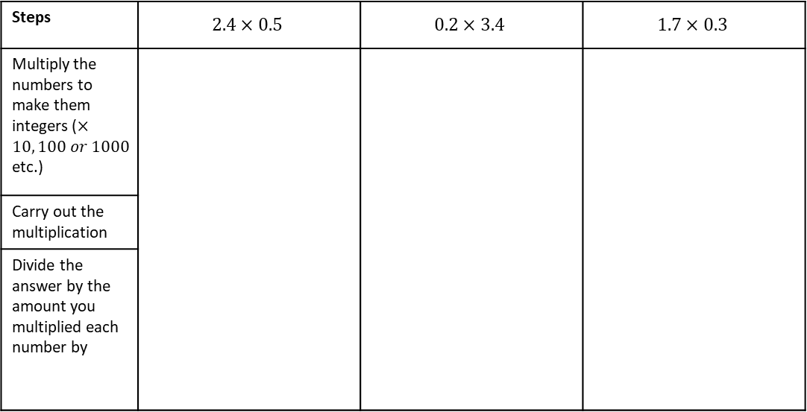
Independent Practice
1. Work out.
a) 2.4 × 2
b) 2.4 × 3
c) 1.6 × 2
d) 1.6 × 4
e) 1.6 × 7
f) 2 × 1.6
g) 5 × 0.4
h) 0.21 × 4
i) 0.65 × 7
j) 4.16 × 6
k) 6.34 × 9
l) 7.32 × 8
Multiplying decimals by decimals
Example 4 - I do…
Example 5 – We do…
Example 6 – You do…
Steps | $$2.4×0.5$$ | $$0.2×3.4$$ | $$1.7×0.3$$
Multiply the numbers to make them integers ($×10, 100 or 1000$ etc.)
Carry out the multiplication
Divide the answer by the amount you multiplied each number by

Slide 7
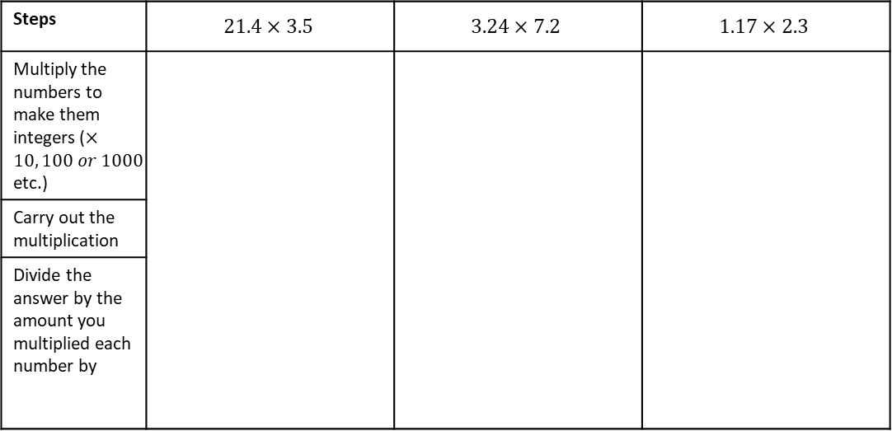
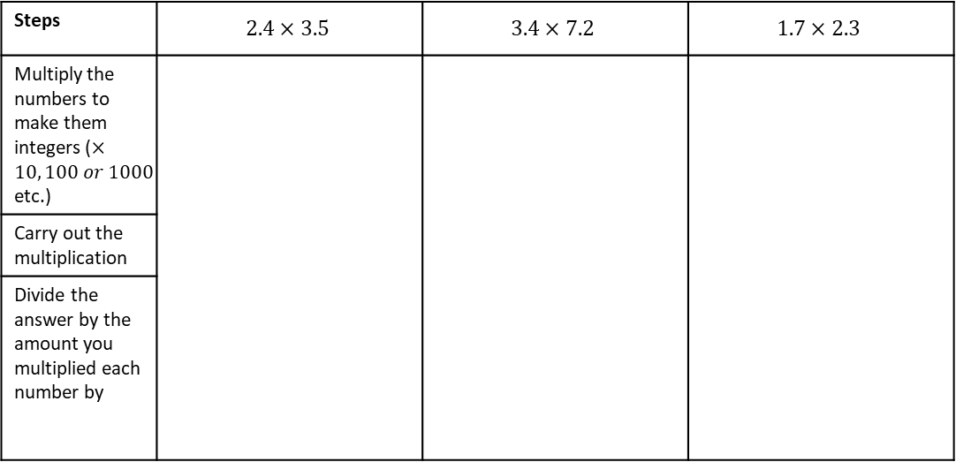
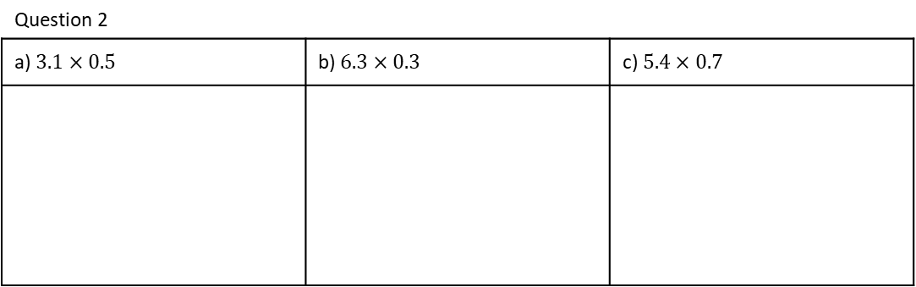
Example 7 – I do…
Example 8 – We do…
Example 9 – You do…
Steps | $$2.4×3.5$$ | $$3.4×7.2$$ | $$1.7×2.3$$
Multiply the numbers to make them integers ($×10, 100 or 1000$ etc.)
Carry out the multiplication
Divide the answer by the amount you multiplied each number by
Example 10 – I do…
Example 11 – We do…
Example 12 – You do…
Steps | $$21.4×3.5$$ | $$3.24×7.2$$ | $$1.17×2.3$$
Multiply the numbers to make them integers ($×10, 100 or 1000$ etc.)
Carry out the multiplication
Divide the answer by the amount you multiplied each number by
Independent Practice
Question 2
a) $3.1×0.5$ | b) $6.3×0.3$ | c) $5.4×0.7$

Slide 8
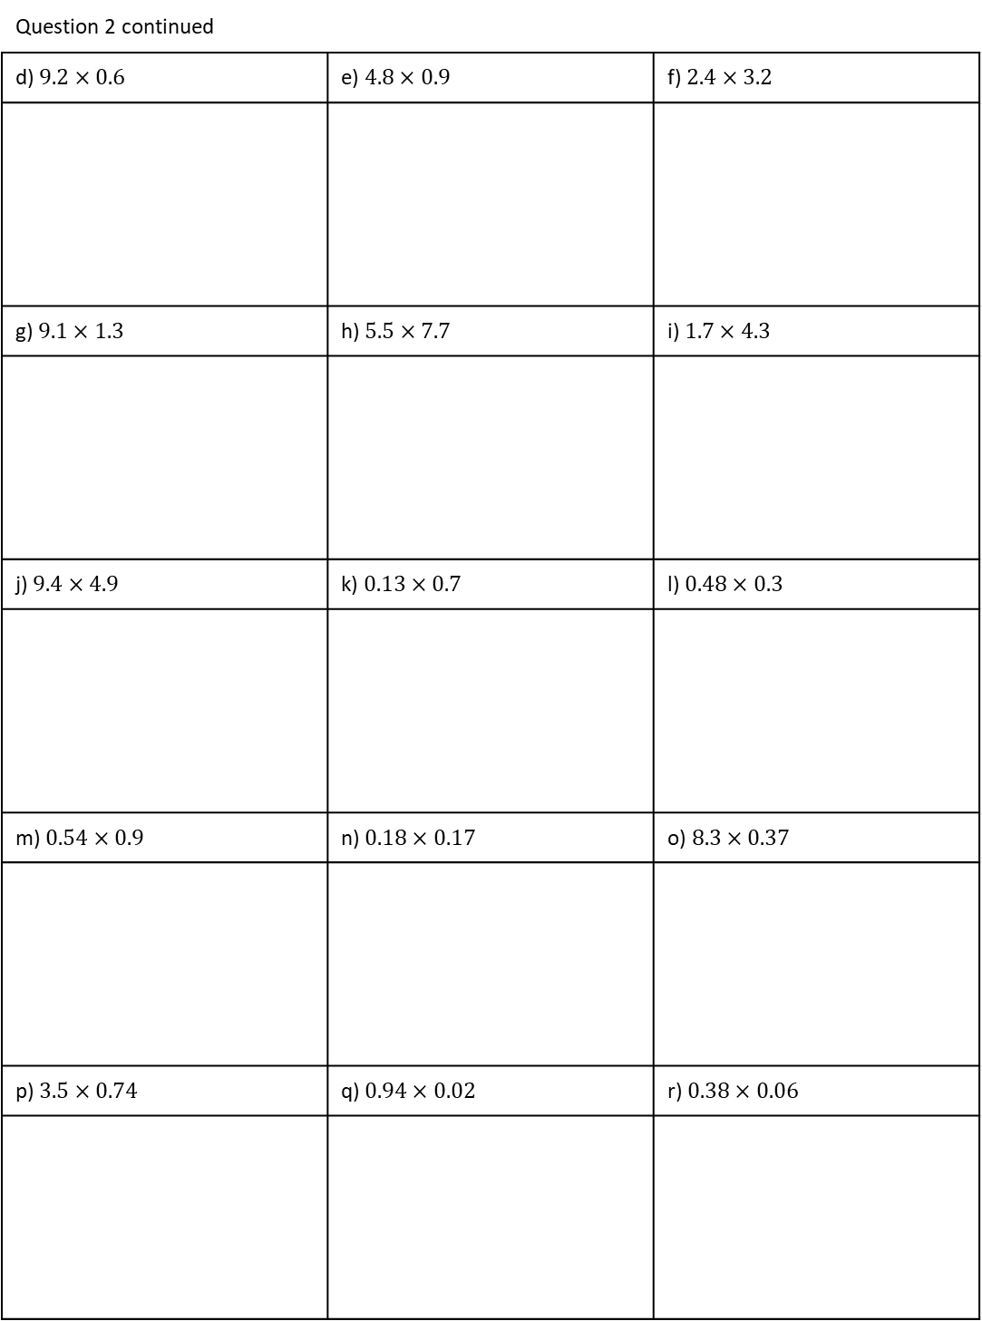
Independent Practice
Question 2 continued
d) $9.2×0.6$ | e) $4.8×0.9$ | f) $2.4×3.2$
g) $9.1×1.3$ | h) $5.5×7.7$ | i) $1.7×4.3$
j) $9.4×4.9$ | k) $0.13×0.7$ | l) $0.48×0.3$
m) $0.54×0.9$ | n) $0.18×0.17$ | o) $8.3×0.37$
p) $3.5×0.74$ | q) $0.94×0.02$ | r) $0.38×0.06$

Slide 9
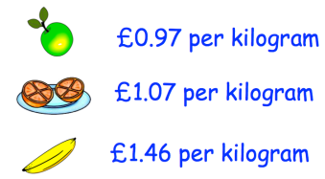
Independent Practice
Question 4 | Question 5
Mr.Jenkins is building a fence for his garden. The fence costs £12.60 per metre to build. The fence is 5.3 metres long. Work out the total cost of building the fence. | Joanne is baking some cupcakes for a party. The recipe states she needs 84.5g sugar to make 6 cupcakes. She wants to multiply each ingredient by 4.5 to make 27 cupcakes. How much sugar does she need?
Question 6 | Question 7
Here are the prices of some fruit in a shop. Find the total cost of 1.2kg of apples, 3.5kg of oranges and 1.9kg of bananas. | The area of a field is 94.8m²? Grass seed costs £2.50 per m². How much is the total cost?
£0.90
£1.70
£1.40

Slide 10






Dividing decimals with different number of decimal places.
Example 13 - I do…
Example 14 – We do…
Example 15 – You do…
Steps | Work out: | Evaluate: | What is:
Multiply each decimal by THE SAME power of 10 so that they are both integers
Divide the two numbers using bus stop division
This is your final answer because it is in proportion to the original question
4.2 $÷$ 0.02
12 $÷$ 0.3
1.2 $÷$ 0.04
0.75 $÷$ 0.5
25.2 $÷$ 0.03
1.47 $÷$ 0.07
Independent Practice
8. Evaluate each of the following.
a) 50 ÷ 0.2
b) 5 ÷ 0.2
c) 5 ÷ 0.1
d) 0.1 ÷ 5
e) 0.1 ÷ 0.05
f) 0.2 ÷ 0.05
g) 84.7 ÷ 0.07
h) 58.2 ÷ 0.06
Notes:
I do – examples filling in

Slide 11
9. Work out.
a) 12.4 ÷ 2
b) 1.24 ÷ 0.2
c) 0.15 ÷ 0.5
d) 0.72 ÷ 0.2
e) 0.48 ÷ 0.3
f) 0.048 ÷ 0.2
g) 0.095 ÷ 0.5
h) 0.072 ÷ 0. 6
10. A carpenter needs some wood cut into 0.7-metre lengths.
How many 0.7-metre lengths can she cut from nine 2.4-metre lengths?
11. You are given that 6.96 ÷ 0.24 = 29.
Use this information to work out the answers to these divisions.
(a) 69.6 ÷ 2.4 (b) 6.96 ÷ 0.29 (c) 6.96 ÷ 58 (d) 2.32 ÷ 29
12. Doris buys a big bag of safety pins. The bag weighs 180 g. Each safety pin weighs 0.6 g. How many safety pins are in the bag?

Slide 12
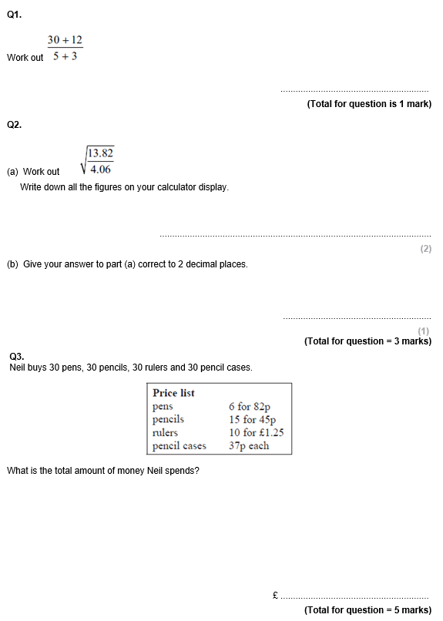
GCSE Past Paper Questions

Slide 13
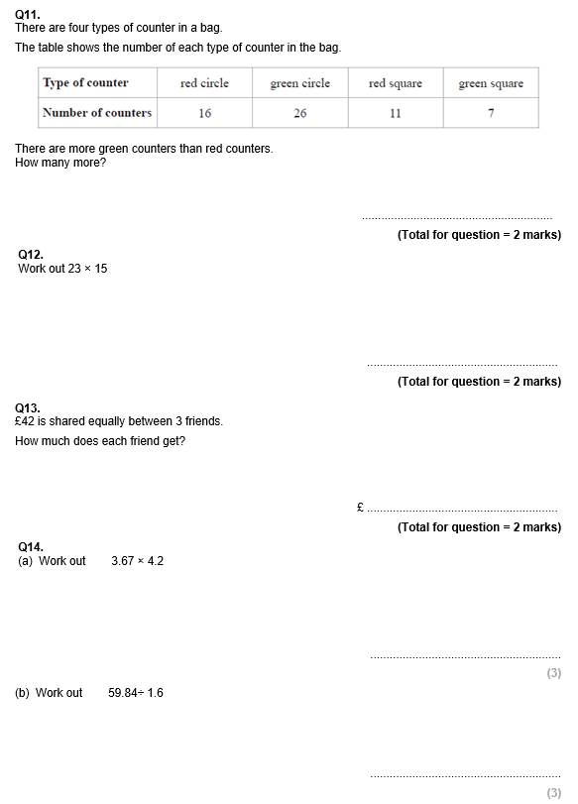

Slide 14
